Slide 1
Multimodal AI Models for Biomedical Image Analysis
Jun Ma
Mar 9, 2026
Innovation Hub

Slide 2
Outline
Biomedical Segmentation Foundation Models
Multimodal Generative Models for Perturbation Prediction
Agentic System: X-ray Copilot
Notes:
This is today’s outline
I’ll be staring with introducing our medical image segmentation foundation models
Followed by presenting the multimodal models for perturbation prediction and report generation together with agentic system for x-ray image analysis
Finally, I’ll share some available resource, including models and datasets that can be used to prompt further research

Slide 3
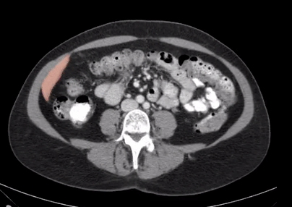
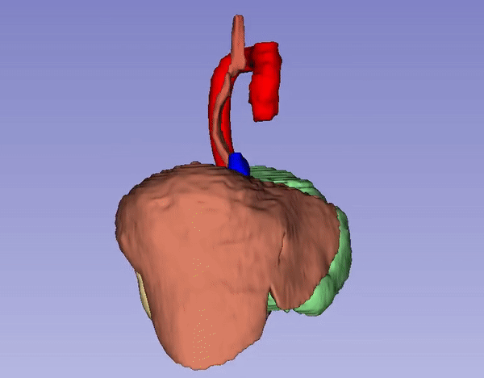
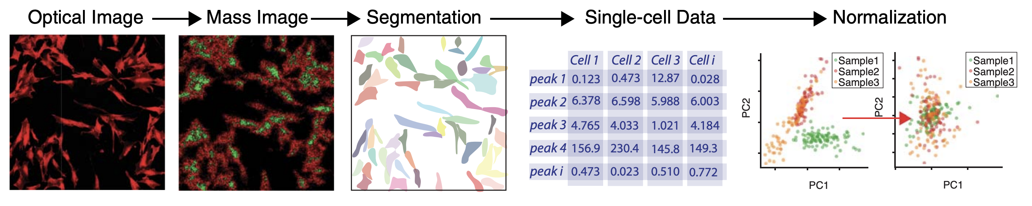
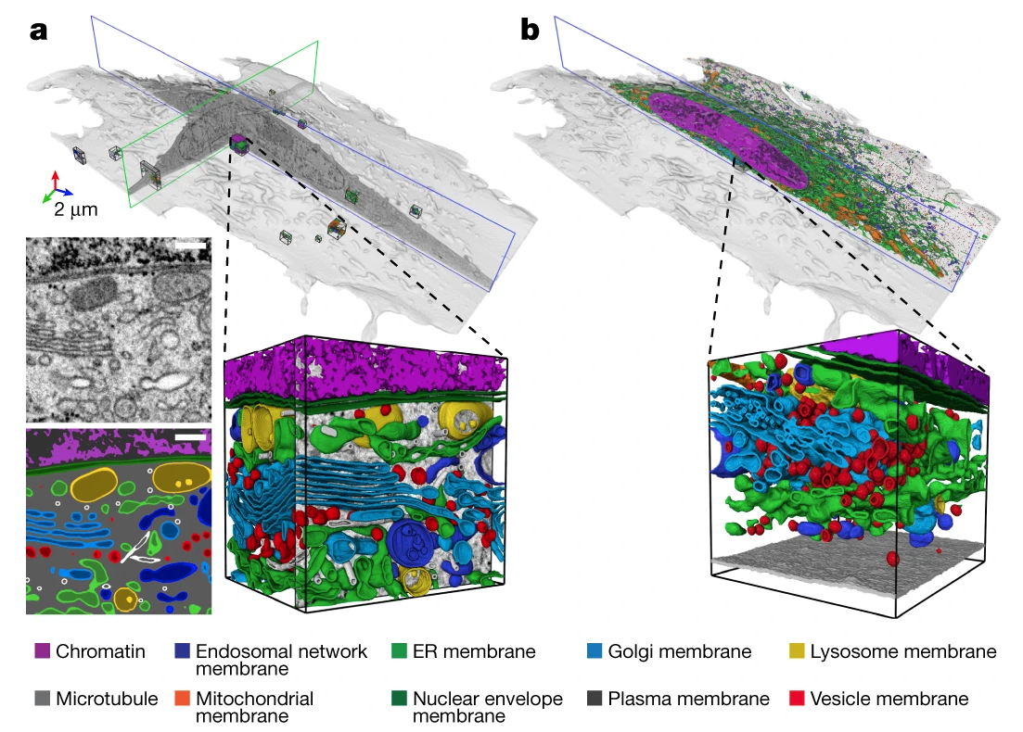
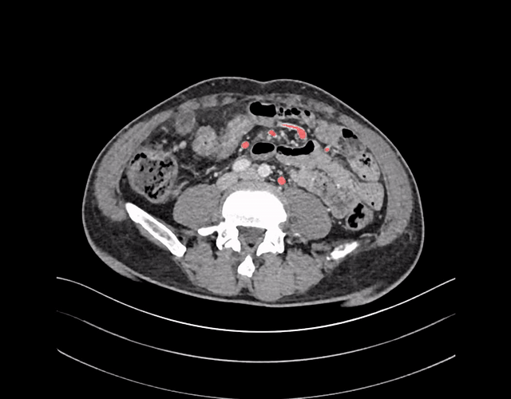
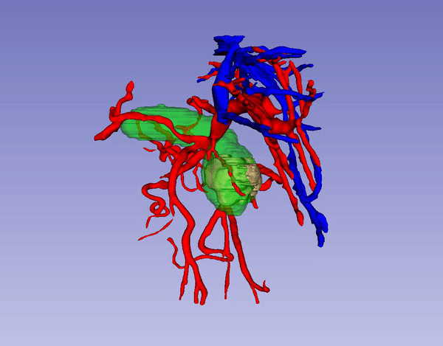
Segmentation: What and Why?
Capolupo, L et al. Science
Cancer early diagnosis
Surgery planning
Cancer microenvironment analysis
Heinrich, L. et al. Nature
Segmentation is the core technology towards precise biomedical image analysis!
Notes:
My research mainly focuses on biomedical image segmentation, aiming to develop algorithms to efficiently and accurately delineate the boundaries of various organs, lesions, and vessels.
The segmentation algorithms have a wide range of applications in clinical and biological practice.
For example

Slide 4
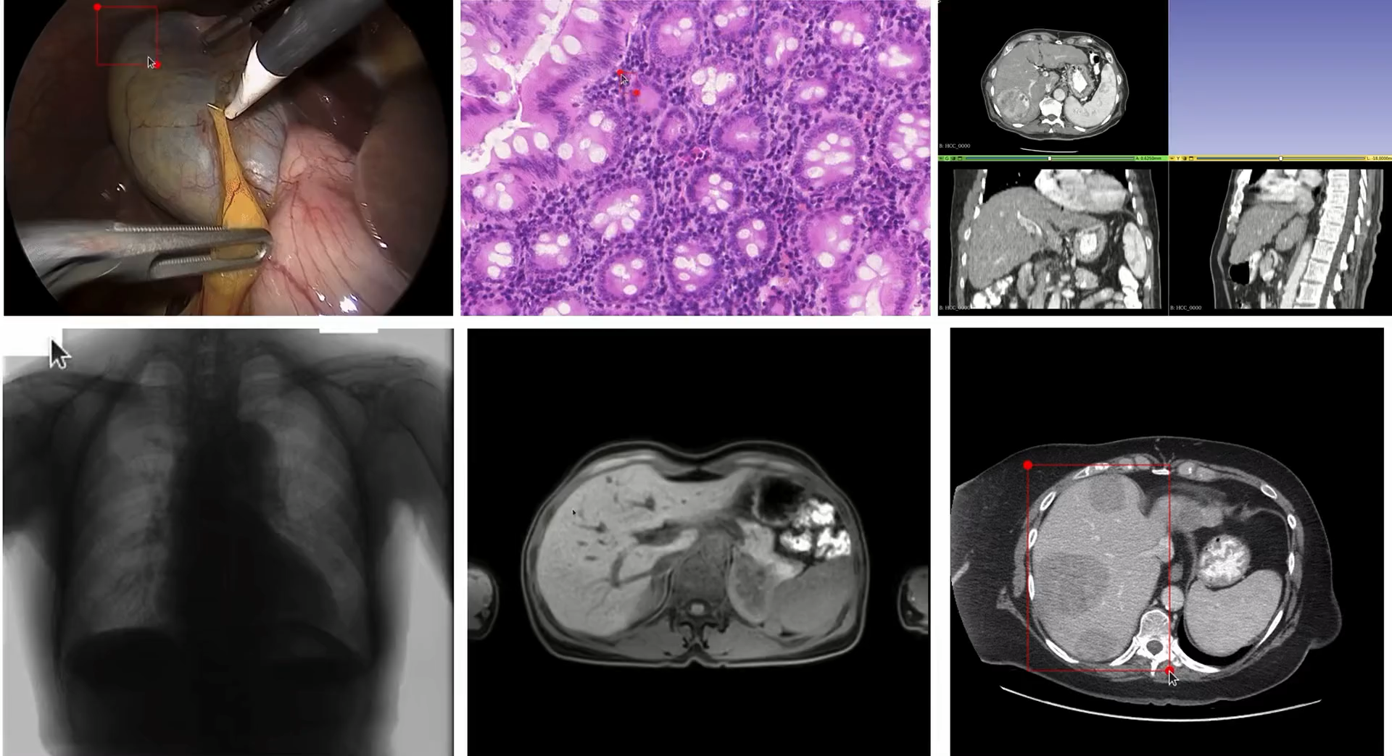
MedSAM: From Specialist Models to Generalist Models

Slide 5
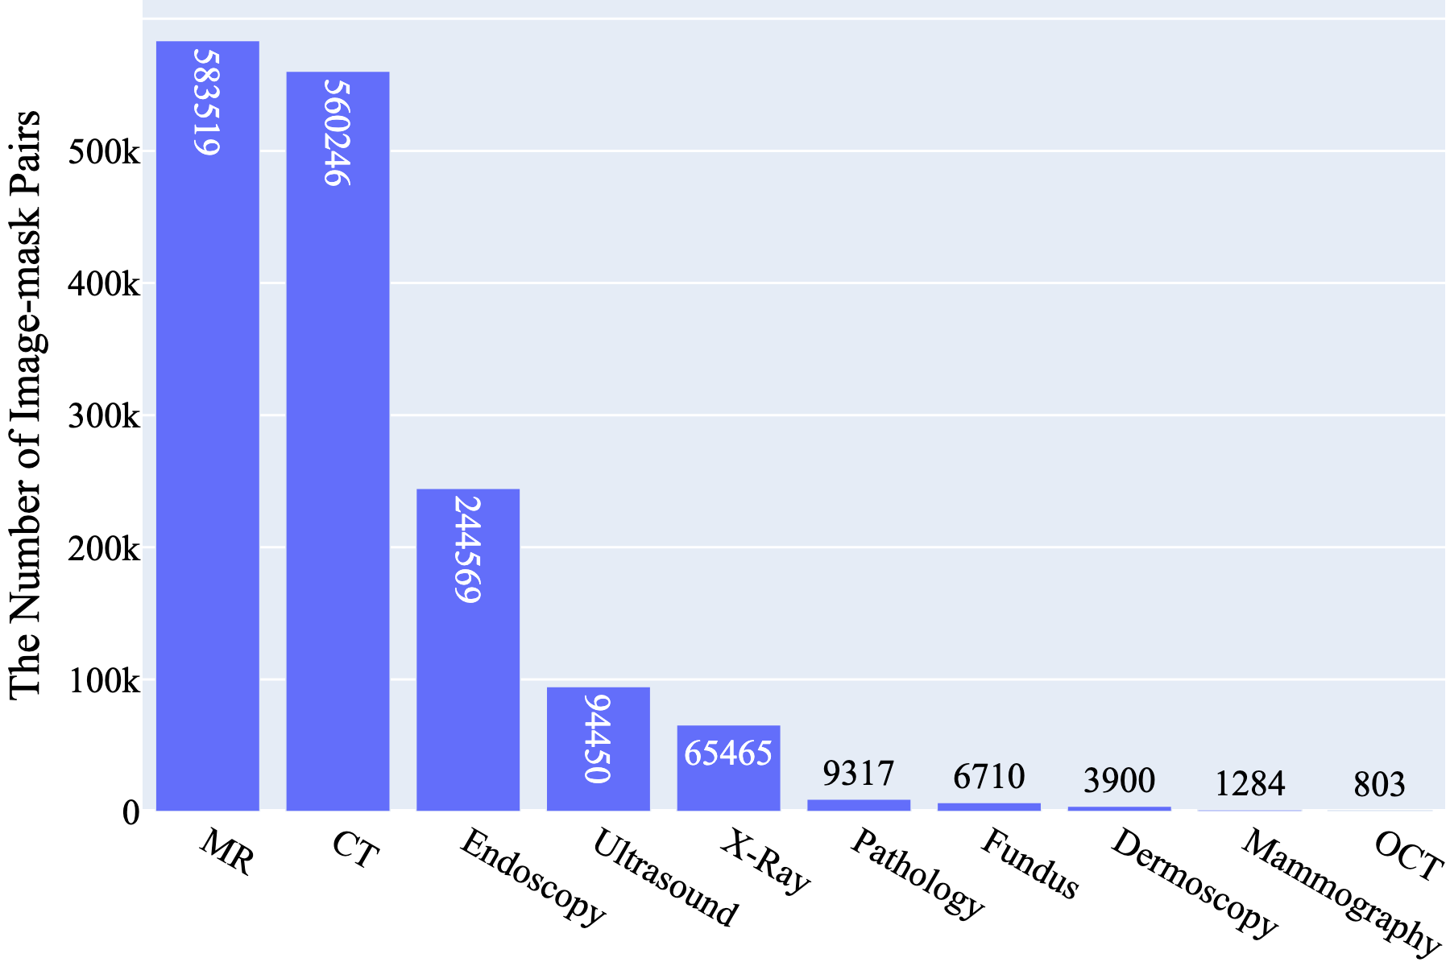
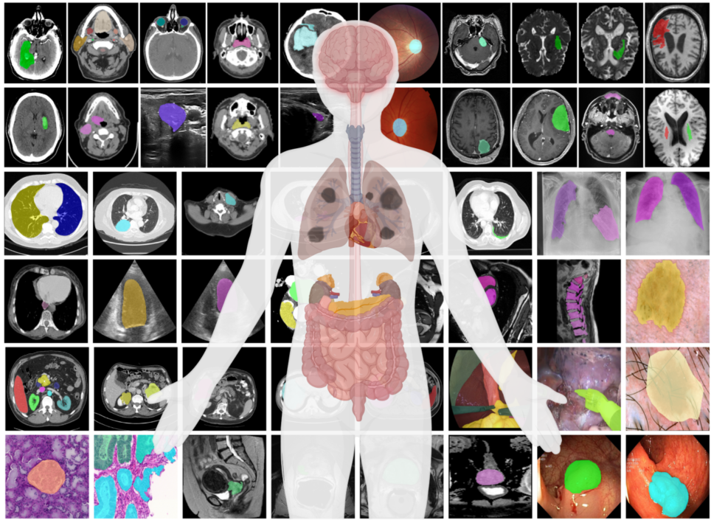
MedSAM: 1.5 M+ Image-mask Pairs
Dataset Features
10 modalities
30+ cancer types
86 internal validation tasks
60 external validation tasks
Notes:
This was the major motivation of medsam. We curated a large-scale
We also designed extensive internal and external validation with 86 and 60 tasks, respectively.

Slide 6
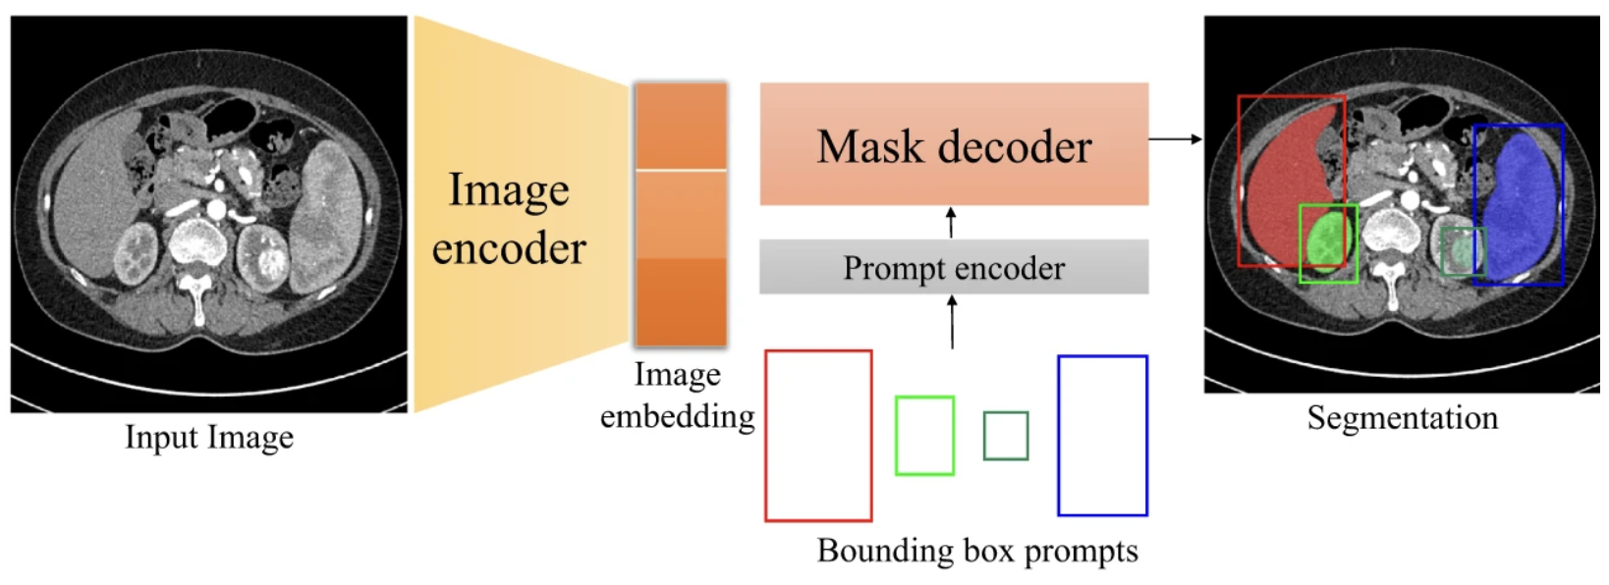
MedSAM: Architecture
Notes:
After having this dataset, how can we train the model?
Most academic group are not affordable
Then, we choose to use transfer learning, allowing us to re-use the pre-trained model weights on natural images instead of training from scratch.
Specifically, we reuse the SAM’s network architecture, including

Slide 7
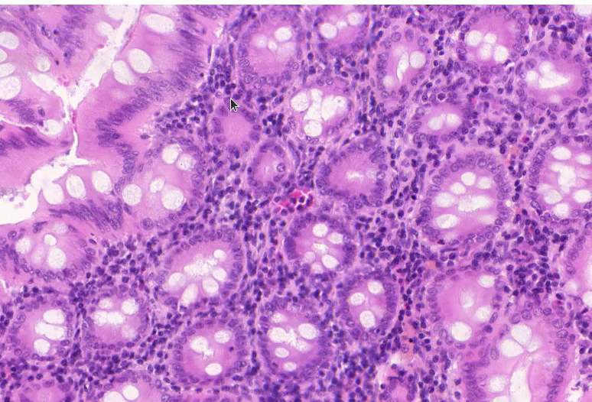
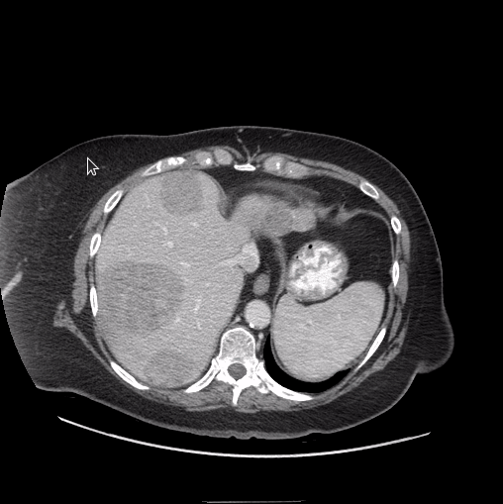
MedSAM: Demo
Gland Segmentation in Pathology Images
Liver and Tumor Segmentation in CT

Slide 8
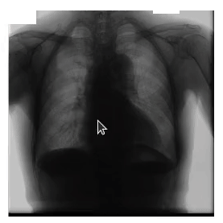
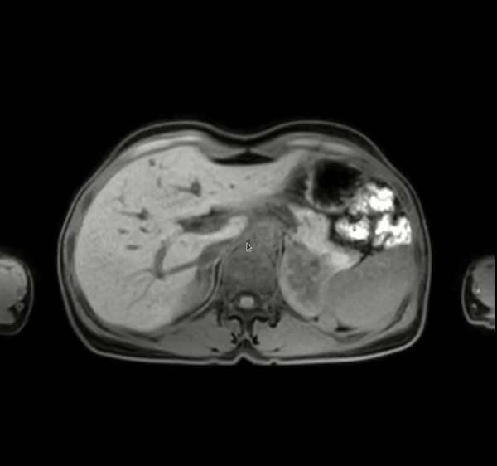
MedSAM: Demo
Abdominal Organ Segmentation in MR
Lungs and Heart Segmentation in X-Ray

Slide 9
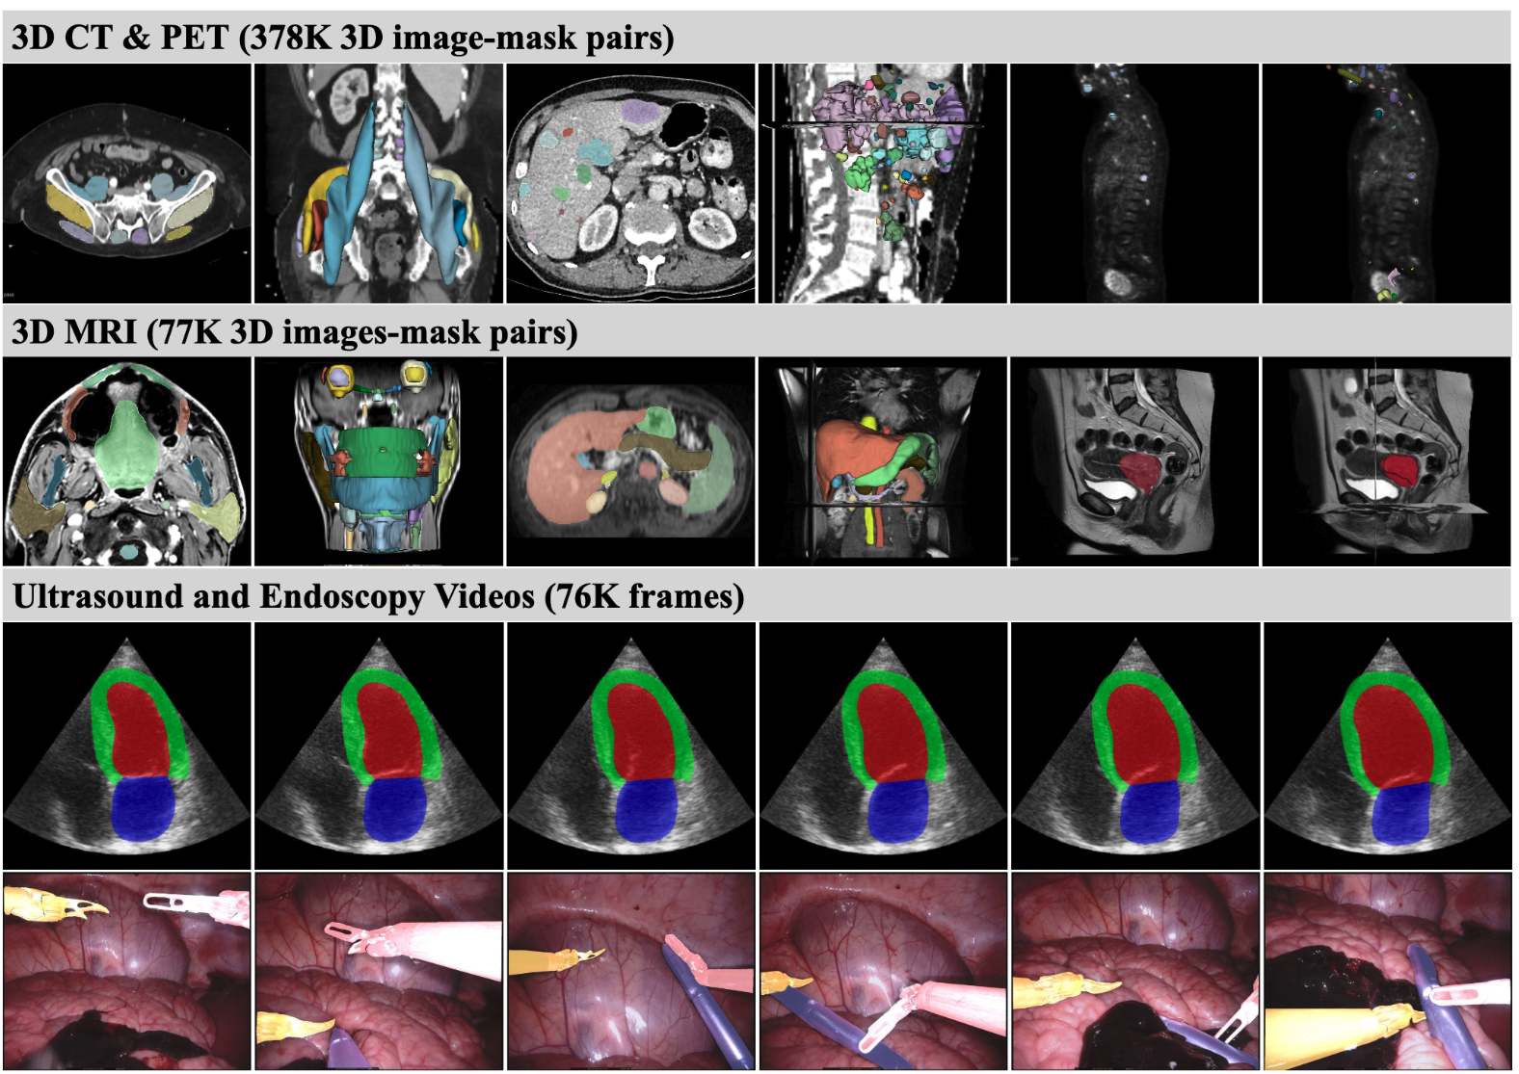
MedSAM2: 3D Image and Video Segmentation
Notes:
Recently, we extended MedSAM to MedSAM2 to enhance its capability for 3D and video image segmentation
Again, we curated a large and diver dataset, including 378K CT and PET image mask pairs, 77K MRI, and 76K ultrasound and endoscopy frames

Slide 10
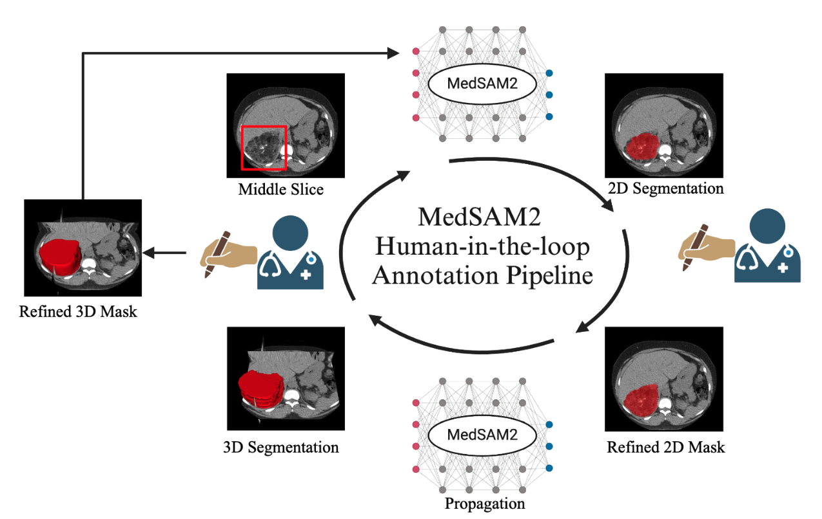
MedSAM2: User Study

Slide 11
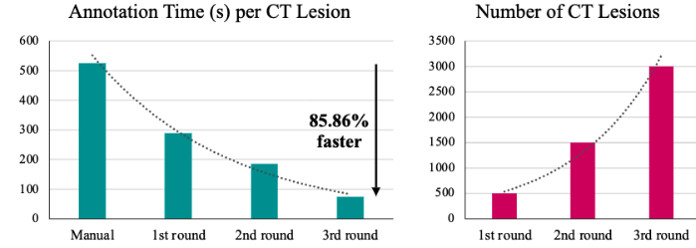
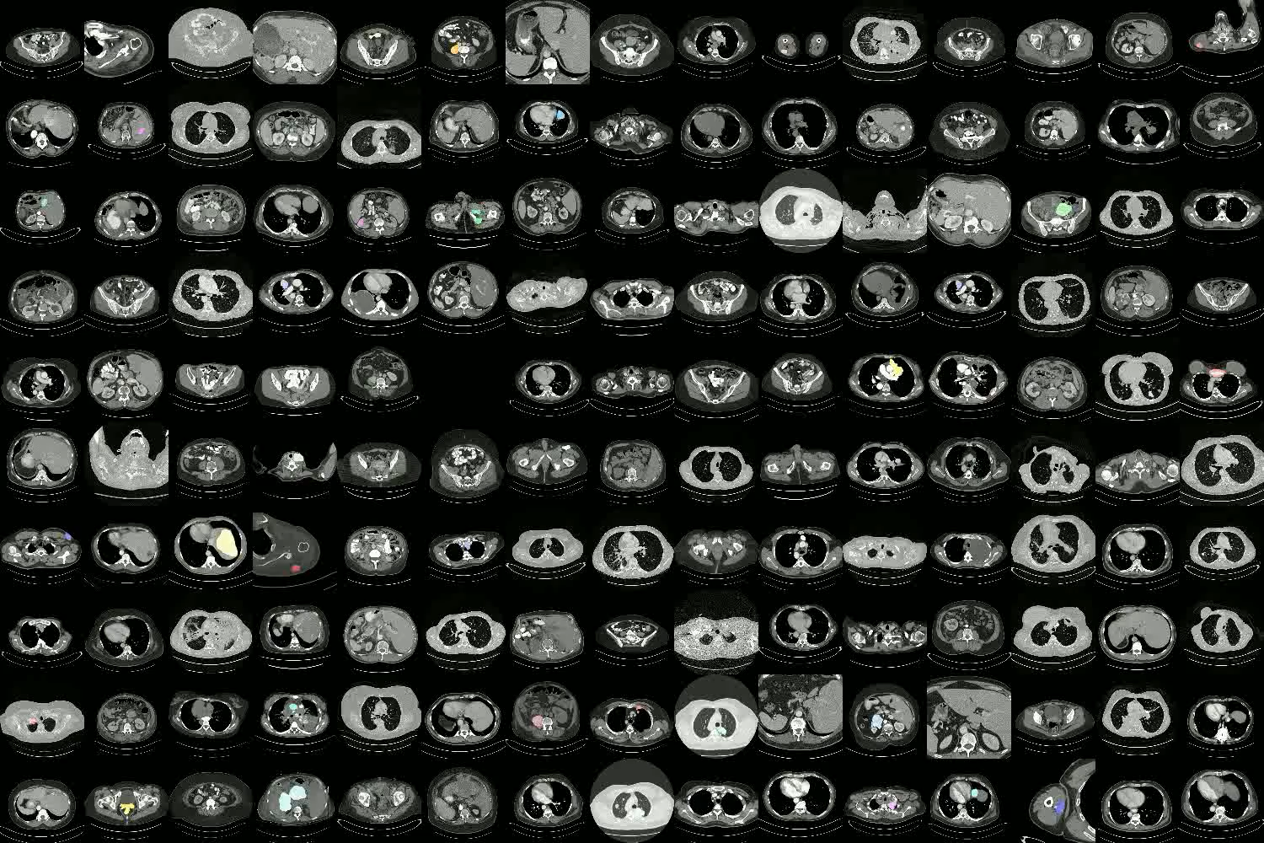
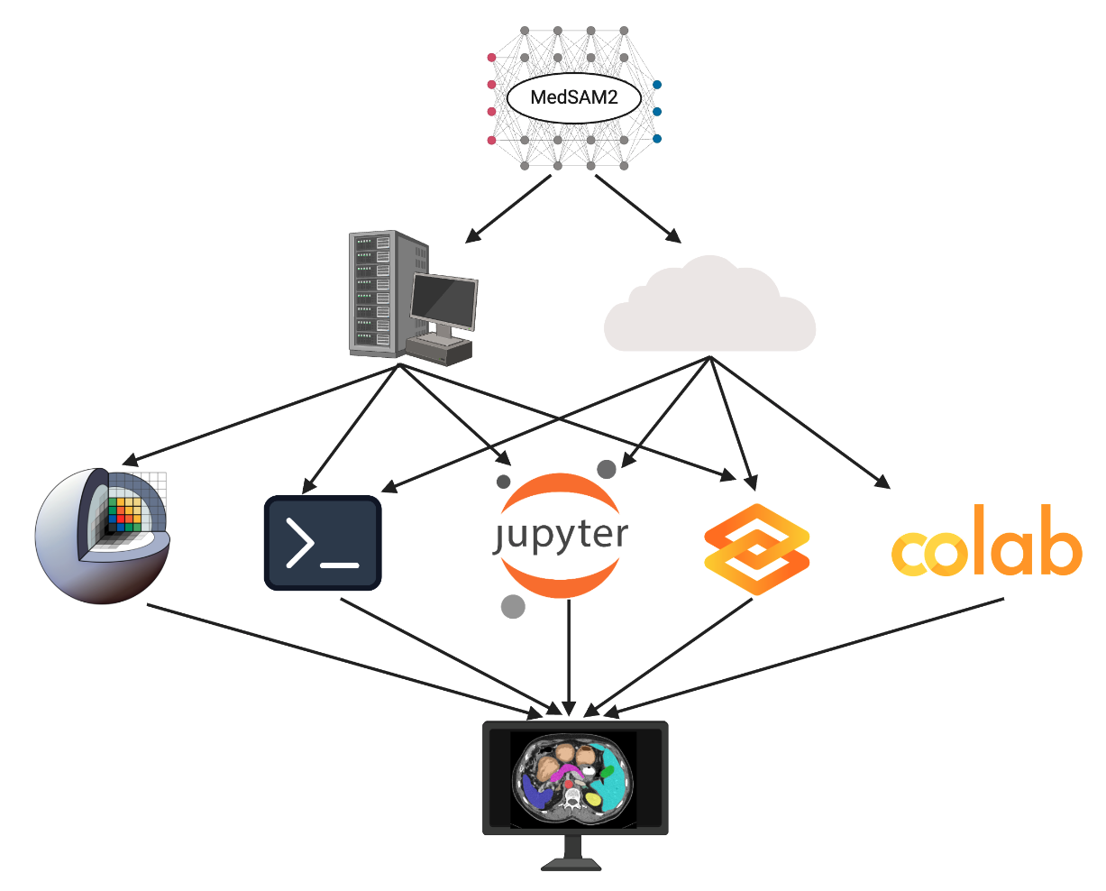
MedSAM2: User Study
Reduce annotation time by 85%+ based on user study on 5000 CT scans

Slide 12
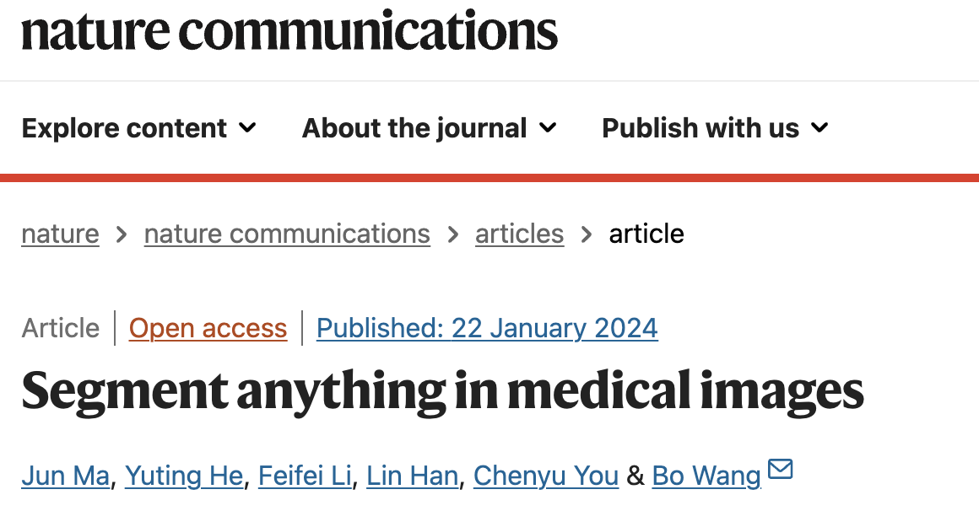
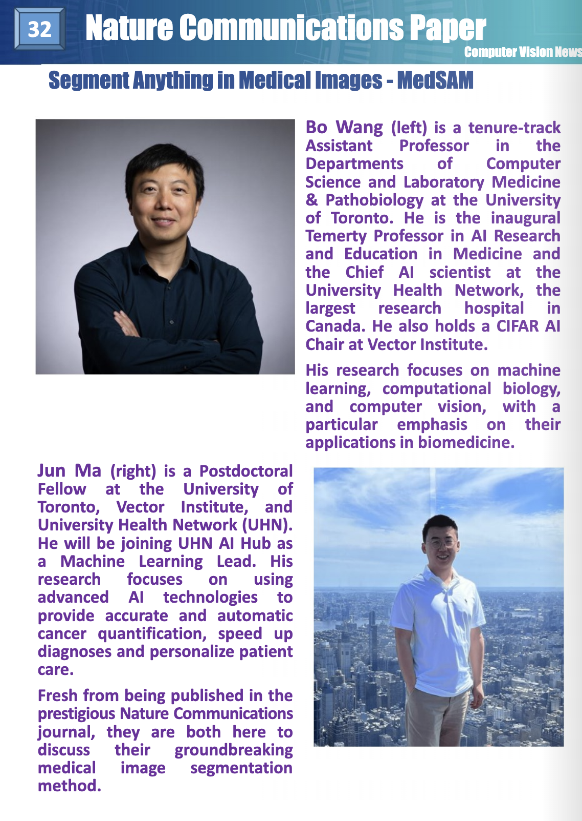
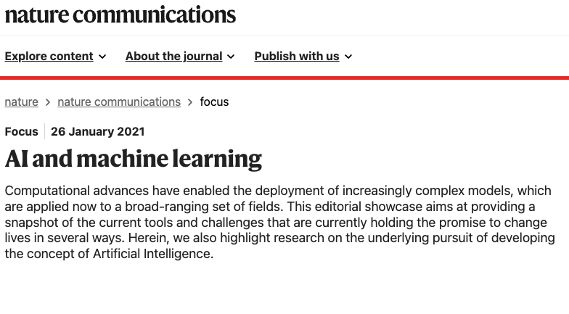
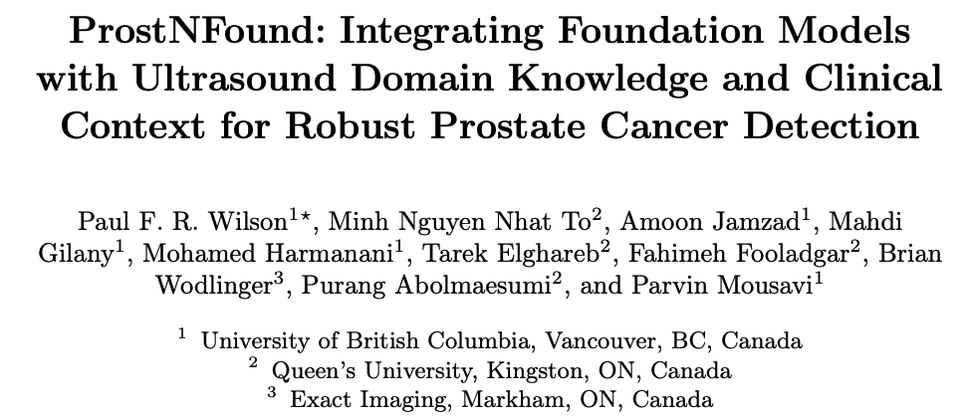
MedSAM: Impacts in the Community
3300+ Google Scholar Citations
The top 50 papers in the field of AI and ML in NCom
MedSAM can be used as a general image encoder
From MICCAI 2024 Young Scientist Award Paper:
“MedSAM was chosen due to its superior performance compared to other applicable models with publicly available weights”
https://link.springer.com/chapter/10.1007/978-3-031-72089-5_47
Notes:
We’re excited to see that ﻿our MedSAM has already garnered substantial recognition in the medical imaging community.

Slide 13
Multi-modal Generative Model for
Perturbations Prediction and Report Generation
Notes:
Now we have introduced two foundation models for general medical image segmentation and cell segmentation.
In the 2nd part, I’d like to share how we use generative models to build virtual cell.

Slide 14

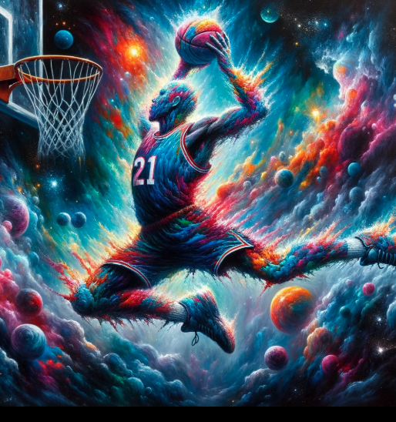
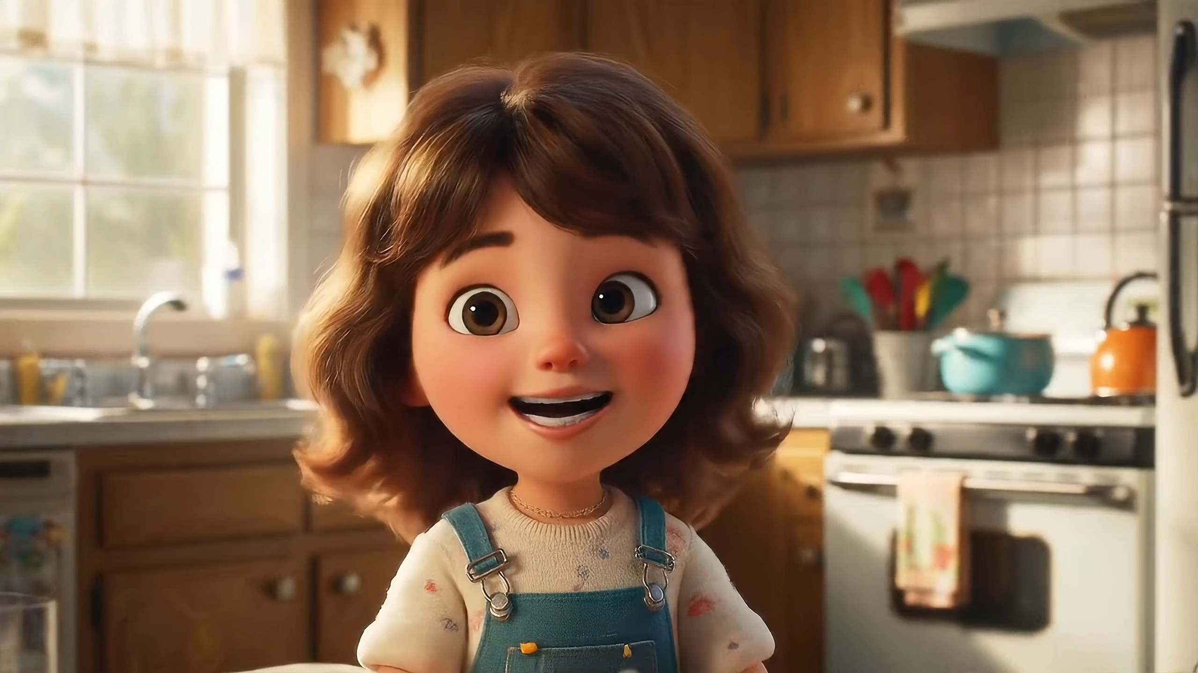
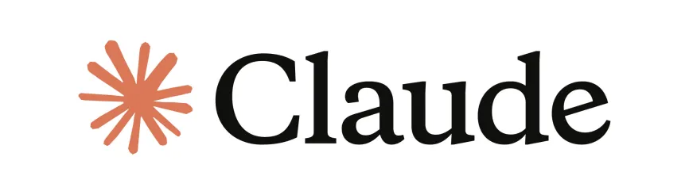
Generative Models
Text Generation
Image Generation
Video Generation
This medium shot, with a shallow depth of field, portrays a cute cartoon girl with wavy brown hair, sitting upright in a 1980s kitchen. Her hair is medium length and wavy. She has a small, slightly upturned nose, and small, rounded ears. She is very animated and excited as she talks to the camera. (Veo-Google)
An expressive oil painting of a basketball player dunking, depicted as an explosion of a nebula. (DALL-E OpenAI)
Notes:
We have witnessed significant progress in generative models. Such as chatgpt for text generation, DALLE for image generation and even video generation

Slide 15

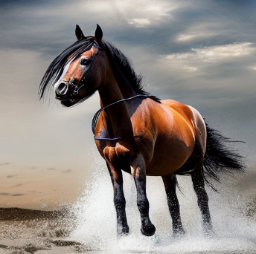
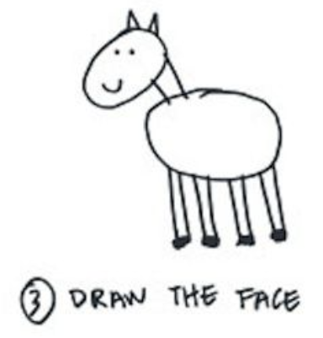
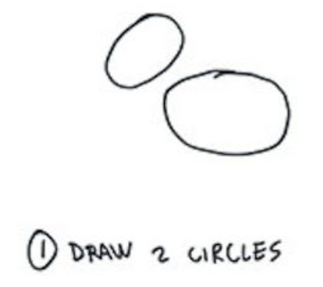
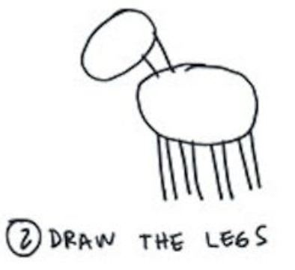
Generative Model: Use Case
How to draw a horse?
Add details
How can this technology be used for healthcare?
Notes:
Here is a personal example about how I improve my drawing skill with generative model
Three years ago, this was a joke
But now it is reality

Slide 16
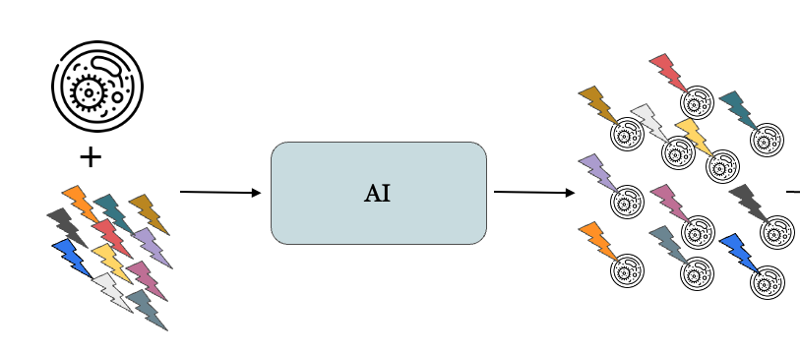
AI for Cellular Morphology Prediction
How cell morphology changes under different perturbations
Notes:
In cell biology, One of the important tasks is to understand how cell morphology changes under different perturbations
However, traditional experiment-based pipeline are resource intensive and time-consuming.
Machine learning and generative models have shown to be promising tools to provide insight into cellular dynamics stimulated by different types of perturbations,

Slide 17
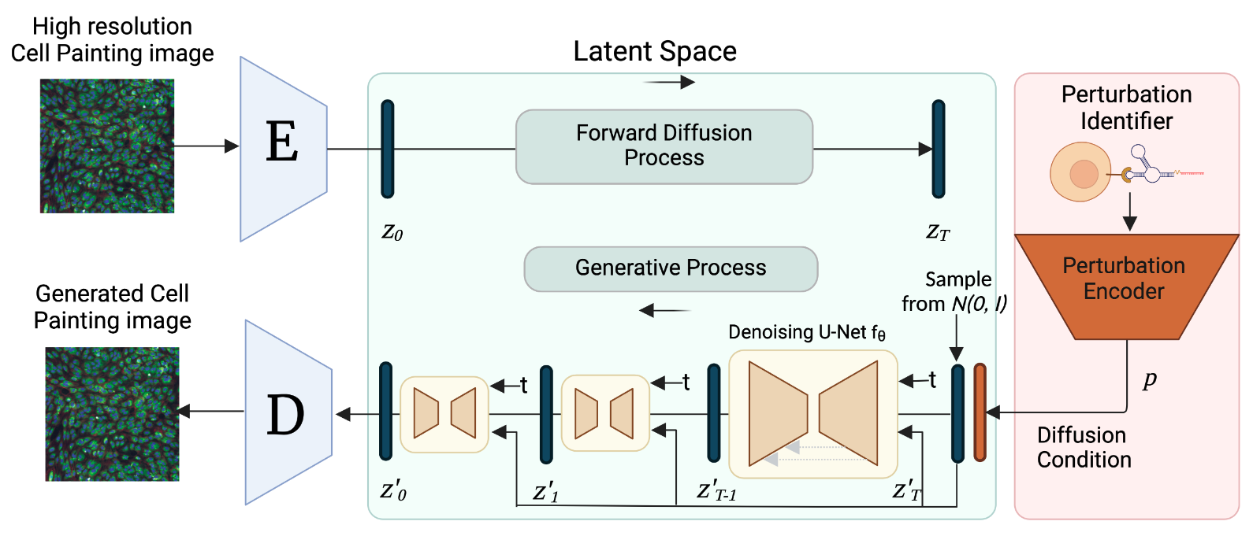
MorphoDiff: Method
Using generative AI to model cellular phenotype changes under chemical and genetic perturbations
Navidi Z, Ma J, Miglietta EA, Liu L, Carpenter AE, Cimini BA, Haibe-Kains B, Wang B. MorphoDiff: Cellular Morphology Painting with Diffusion Models. ICLR 2025 (Spotlight, 3.26%)
Notes:
We build a generative AI model that can automatically predict the cell morphological responses through high-resolution microscopy images under various chemical and genetic perturbations.
It contains four modules:
To summarize, the main capability of this generative framework is that the model can generate high-resolution microscopy images based on various perturbations.
Cell is the basic building blocks of life and it’s critical to understand the unique role and function of each individual cell within the human body

Slide 18
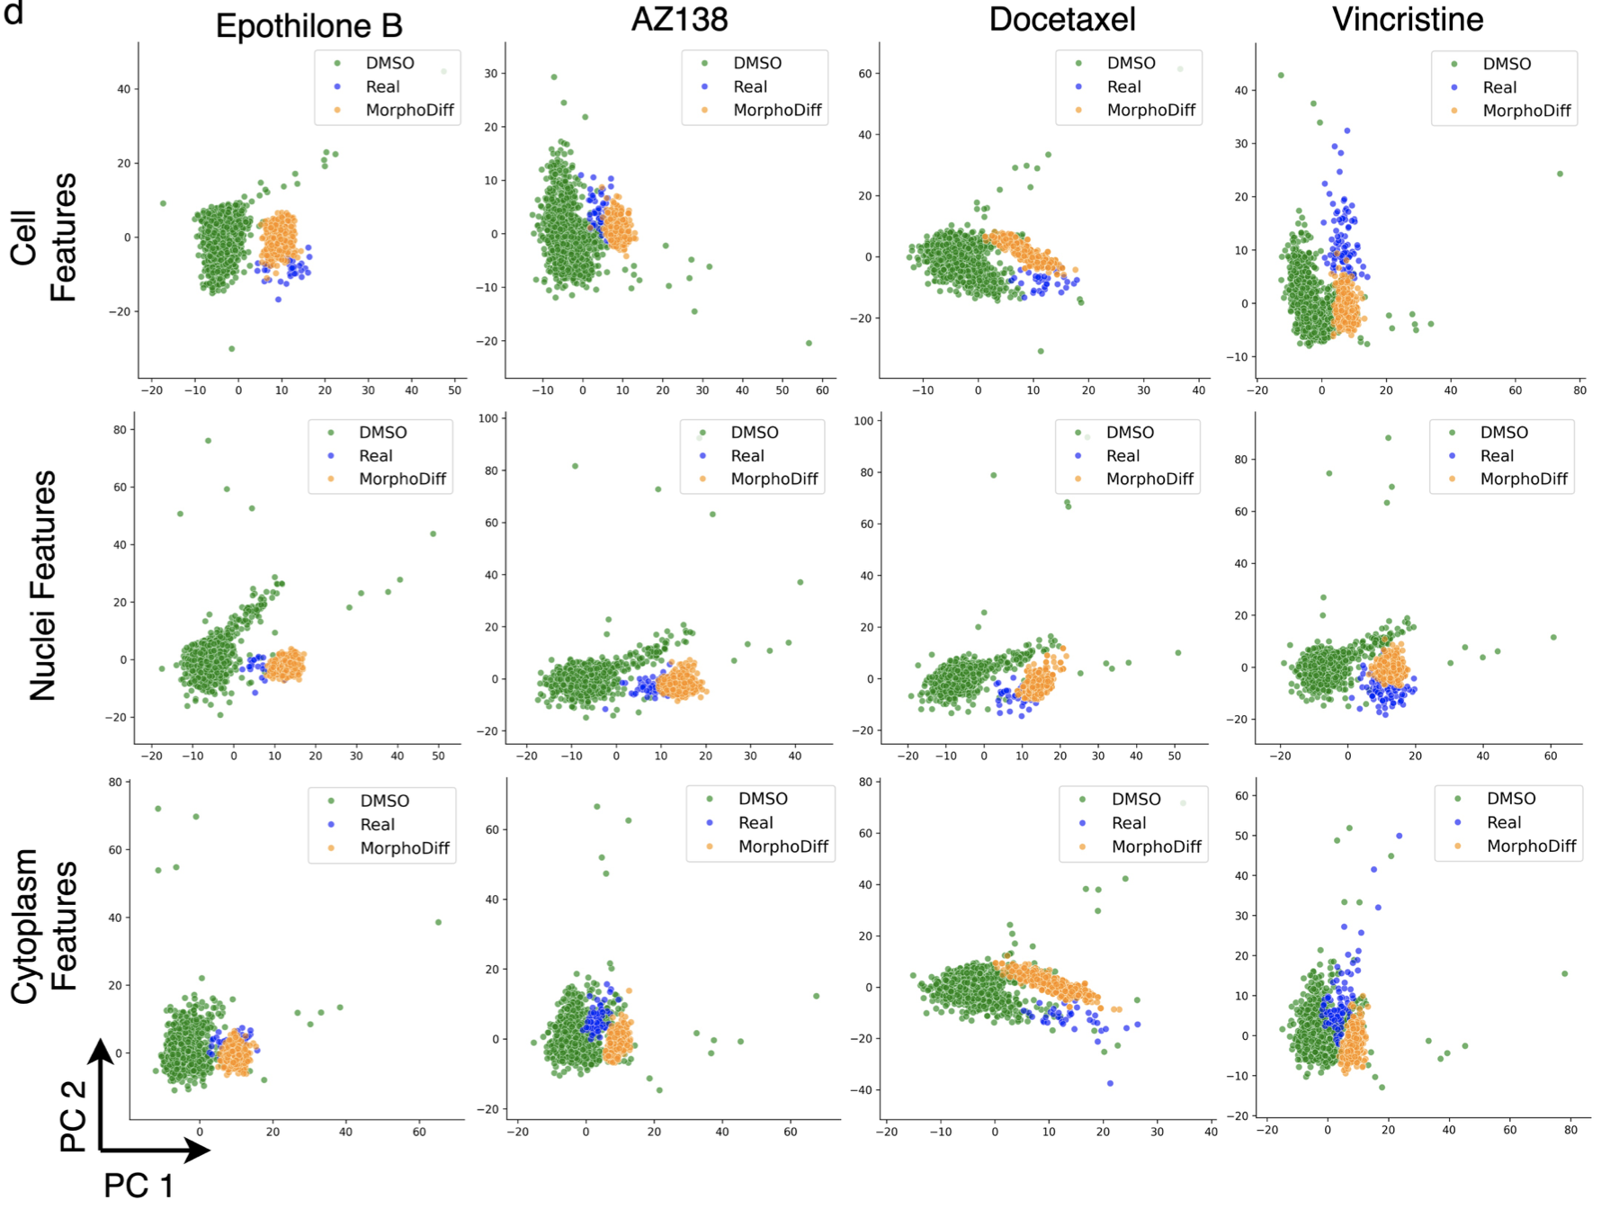
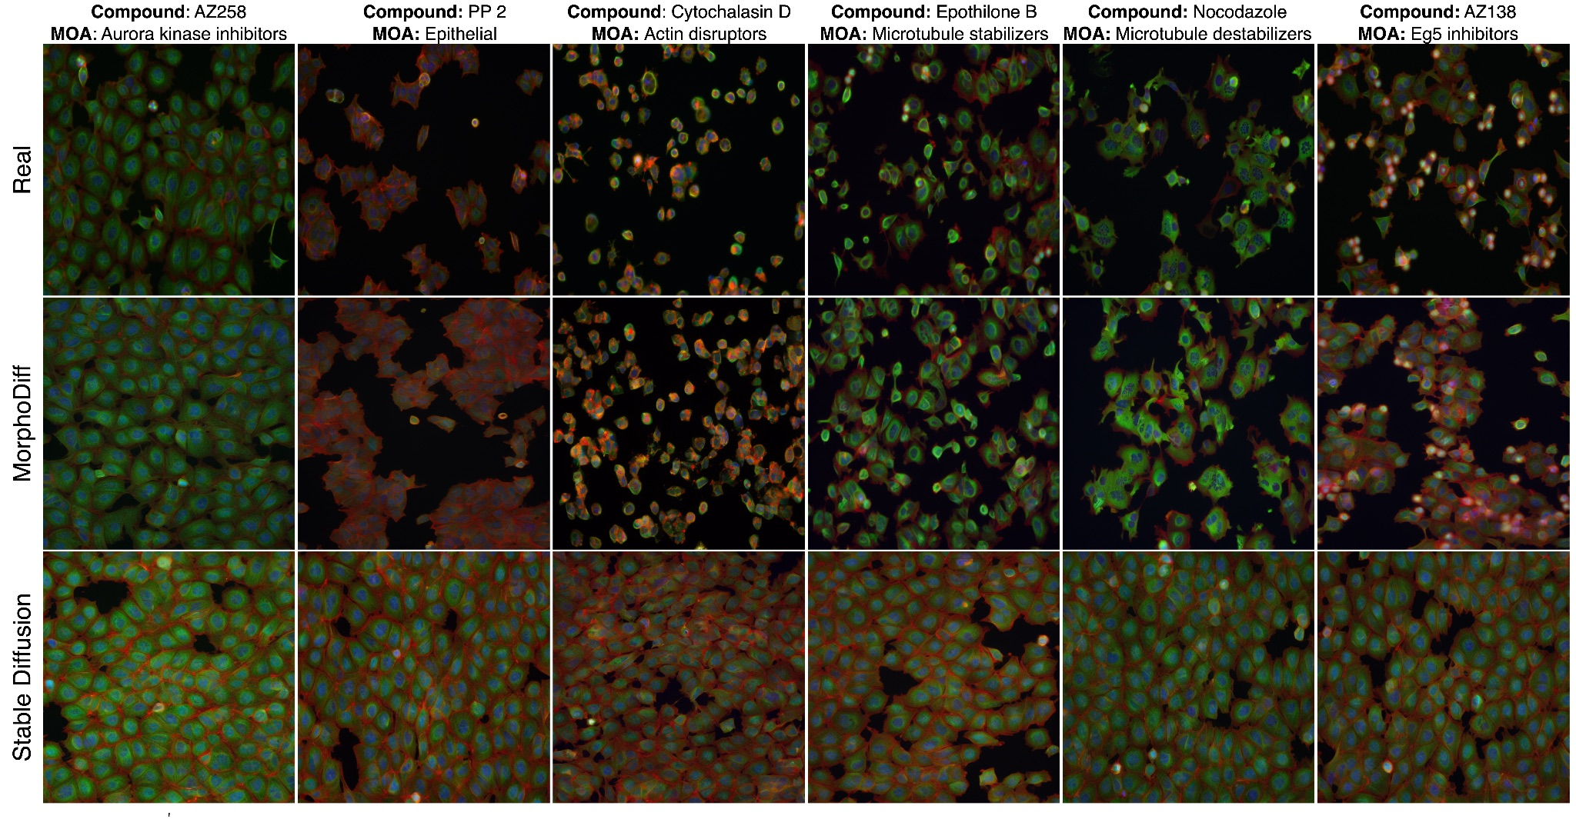
MorphoDiff: Results
Navidi Z, Ma J, Miglietta EA, Liu L, Carpenter AE, Cimini BA, Haibe-Kains B, Wang B. MorphoDiff: Cellular Morphology Painting with Diffusion Models. ICLR 2025 (Spotlight, 3.26%)
Notes:
We conducted extensive experiments to validate the utility of the model.
First we compared the features between generated images and real images.
You
Experiments show that our MorphoDiff learns biologically interpretable features and generates high fidelity images
This has great potential to improve throughput in drug discovery analysis.
captures perturbation-specific cell morphology signals
Our validations of CellProfiler features extracted from real and generated images showed that MorphoDiff generates features align more with the target phenotypic space compared to control DMSO cells.

Slide 19
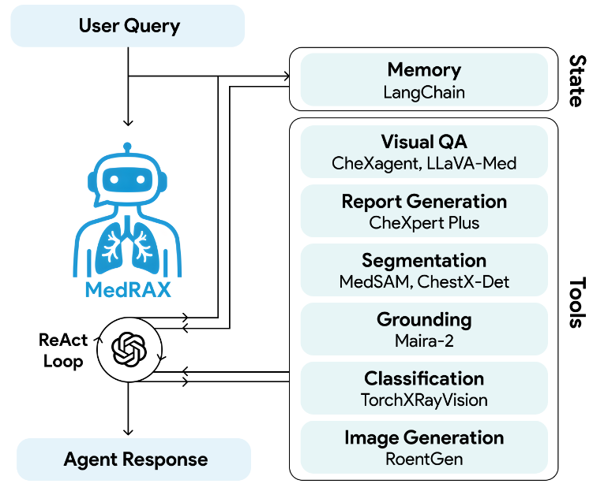
Agentic System for X-Ray Image Parsing

Slide 20
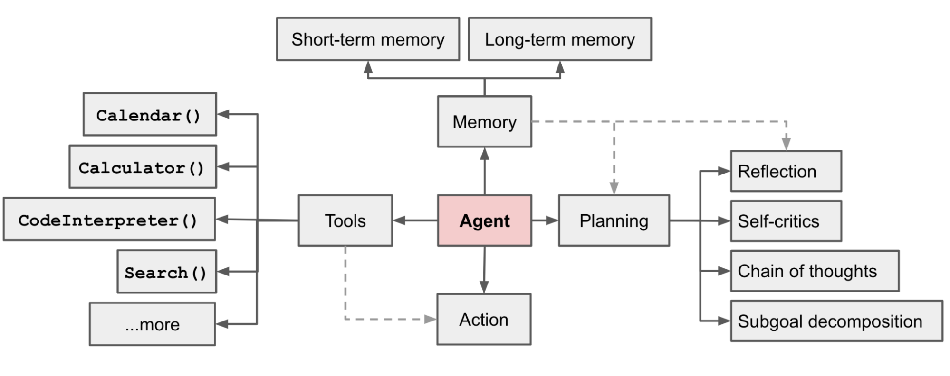
What is an AI Agent?
LLM using tools in a loop
Planning
Memory
Tool use
Action
Lilian Wen, LLM Powered Autonomous Agent: https://lilianweng.github.io/posts/2023-06-23-agent/

Slide 21
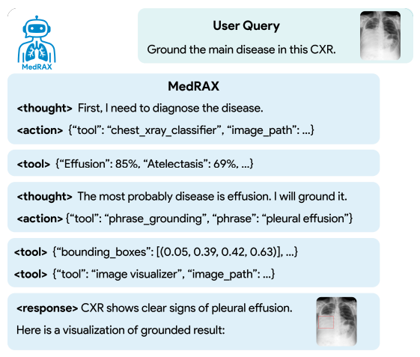
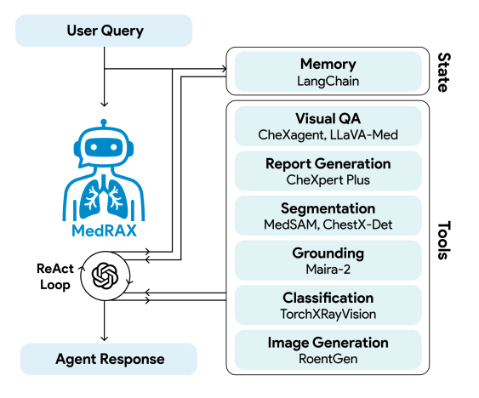
MedRAX: Method
Fallahpour A*, Ma J*, Munim A*, Lyu H, Wang B. MedRAX: Medical Reasoning Agent for Chest X-ray. ICML 2025 Accept Rate: 27%
Notes:
ReAct is inspired by the synergies between "acting" and "reasoning" which allow humans to learn new tasks and make decisions or reasoning.

Slide 22
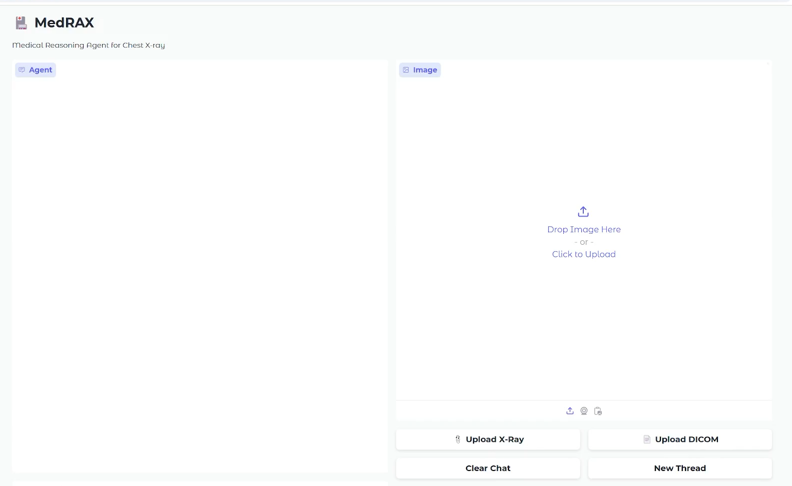
MedRAX: Demo
500,000+ views on twitter
Proposed benchmark was used by XAI team in Grok 4
https://bowang-lab.github.io/MedRAX/
Fallahpour A*, Ma J*, Munim A*, Lyu H, Wang B. MedRAX: Medical Reasoning Agent for Chest X-ray. ICML 2025 Accept Rate: 27%

Slide 23
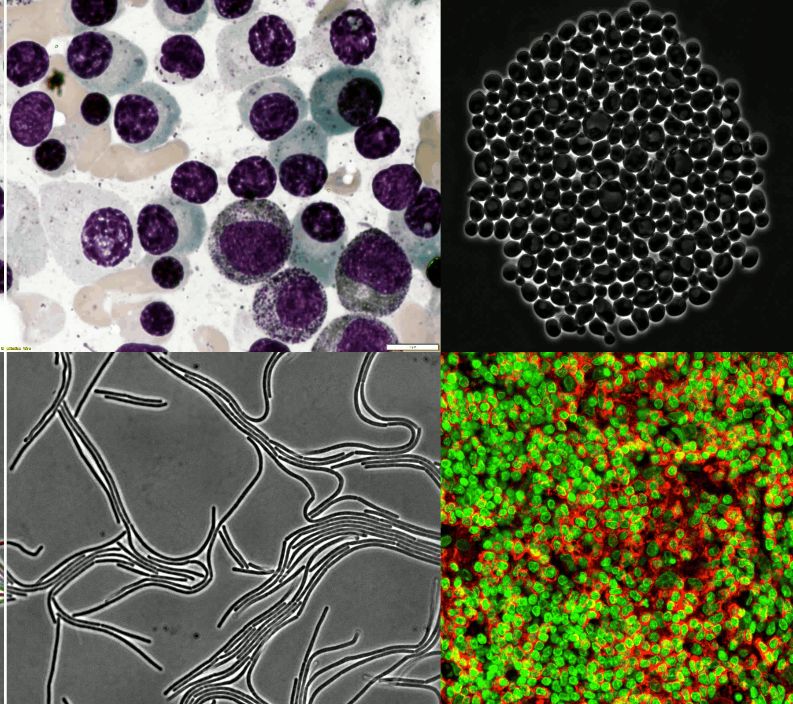
Summary
Segmentation FMs
Multimodal Generative Models
X-ray Agents

Slide 24
References
Jun Ma, et al. Wang B., “Segment Anything in Medical Images” Nature Communications, (2024)
Jun Ma, Bo Wang. Towards foundation models of biological image segmentation. Nature Methods 20, 953–955 (2023).
Jun Ma, et al., Gary D. Bader, Bo Wang. The Multi-modality Cell Segmentation Challenge: Towards Universal Solutions. Nature Methods, 21, 1103–1113 (2024)
Jun Ma, et al., the FLARE Challenge Consortium, Bo Wang. Unleashing the Strengths of Unlabeled Data in Deep Learning-assisted Pan-cancer Abdominal Organ Quantification: the FLARE22 Challenge. Lancet Digital Health, 6, e815-826 (2024).
Jun Ma, et al., Bo Wang. Efficient MedSAMs: Segment Anything in Medical Images on Laptop. Under revision in Nature Biomedical Engineering
Zeinab Navidi, Jun Ma, Esteban Miglietta, Le Liu, Anne E Carpenter, Beth A Cimini, Benjamin Haibe-Kains, Bo Wang. MorphoDiff: Cellular Morphology Painting with Diffusion Models. ICLR 2025 (Spotlight, 3.26%)
Adibvafa Fallahpour*, Jun Ma*, Alif Munim*, Hongwei Lyu, Bo Wang. MedRAX: Medical Reasoning Agent for Chest X-ray. ICML 2025
Mohammed Baharoon*, Jun Ma*, Congyu Fang, Augustin Toma, and Bo Wang. Exploring the Design Space of 3D MLLMs for CT Report Generation, MICCAI, 2025
Thanks for Listening!

Slide 25
Fun Fact
Have you learned how to draw a horse?
Jun Ma
Notes:
If you’re wondering why I learn to draw a horse, this is because it is my last name!

